Slide 1
A Startup Checklist for the School Health Office
Knowledge
Skills
Abilities
Giuseppina Pagnotta, MSN, RN, NCSN
School Nurse Neptune Township Schools
Laura T Jannone EdD, RN, CSN-NJ, FNASN
Retired Associate Professor, Coordinator of the School Nurse Program Monmouth University
Standards & Practice Chair NJSSNA

Slide 2
Poll Years of Experience in School Nursing
Brand New First Year
1-5 Years
6-10 years
10-20 years
Over 20 years

Slide 3
Planning, Ordering, & Organizing Supplies
Supply List
Where do you order from?
Budget$$
What products do you needs for population, grades, special needs?
How many students in the school ($1 per child)?
Inventory List of items on hand and projected needs?
OFFICE SUPPLIES
HEALTH CARE/NURSING SUPPLIES

Slide 4
Preparing Emergency and Daily First Aid
AED
WOUND CARE
DIAGNOSTIC
RX AND NON-RX
RESPIRATORY

Slide 5
Tips for Managing Files such as Students Transfers, Emergency Cards & Gym Exclusions
LABELED BINDERS
LIVING GOOGLE DOCS
EMAILS TO STAFF

Slide 6
Assessing District Policies
MEDICATIONS
NARCAN
DNR
ANALPHYLAXIS
CARDIAC EMERGENCIES

Slide 7
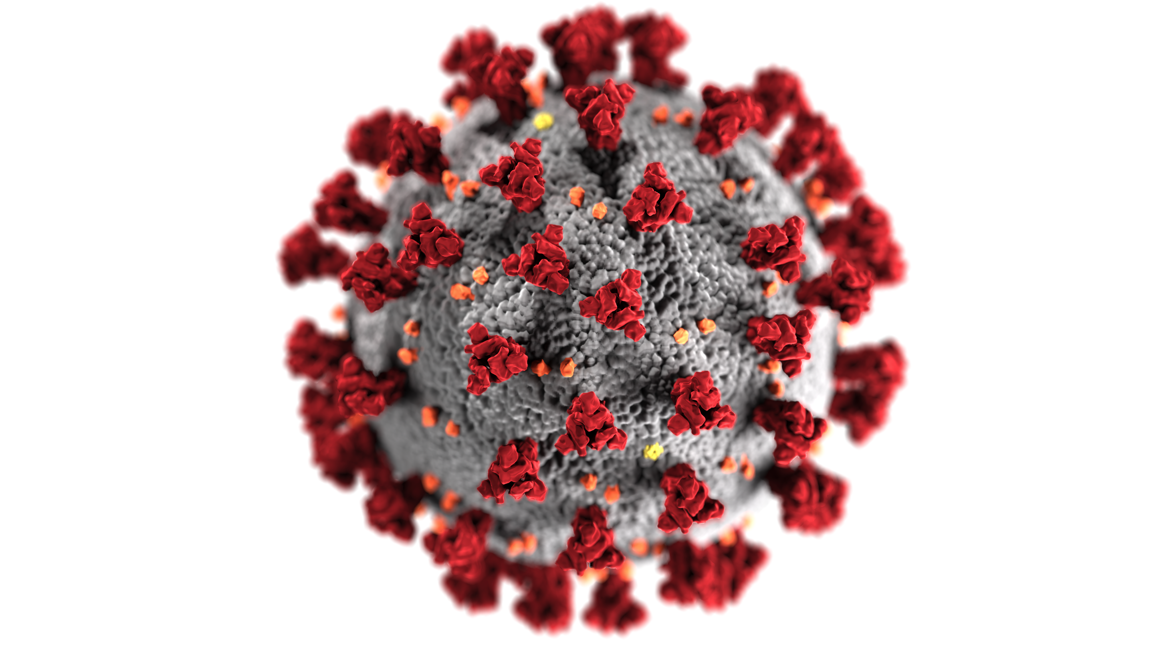
Locating and Reviewing Updated COVID Policies
The New Jersey State School Nurses Pandemic Tool kit can be accessed using the following link.
https://www.njssna.org/resources/pandemic-toolkit
Centers for Disease Control
and Prevention
New Jersey Dept of Health

Slide 8
Administration of Medication-Forms, Permissions, & Documentation
Click on image for link

Slide 9
Establishing a District Contact List & Support Systems

Slide 10
Exploring Opportunities for Mentorship
Professional national, state, & local
nursing associations
Fellow district and non-district
school nurses
Nursing educator mentor

Slide 11
Confidence and Knowledge Levels
Have they risen after this workshop?
What assisted you in the workshop?
Were there areas that were clarified for you as a school nurse?
Take a Deep Breath
Enjoy the Journey

Slide 13
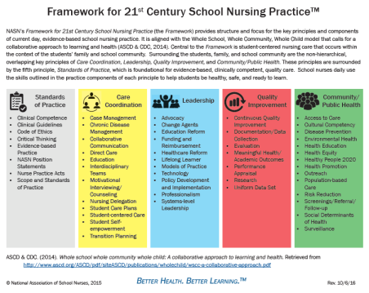
Resources
https://schoolnursenet.nasn.org/covid19ref/home
https://www.pathlms.com/nasn/courses/25804

Slide 14
Questions

Slide 15
Reference and Resources
The National Association of School Nurses has a learning center. See the following link for their “Back to School Toolkit” and link to resources.
https://www.pathlms.com/nasn/courses/25804
Covid-19 references https://schoolnursenet.nasn.org/covid19ref/home
Resources Models & Samples https://www.nasn.org/nasn-resources/models-samples
Promoting Health and Learning – School Nursing Practice in NJ’s Public Schools
https://www.njssna.org/njssna/resources/practice-guide
The New Jersey State School Nurses Pandemic Toolkit can be accessed using the following link.
https://www.njssna.org/resources/pandemic-toolkit

Slide 16
Contacts
Giuseppina Pagnotta, RN, MSN, NCSN
gdiamant@monmouth.edu
Laura Jannone EdD, RN, CSN-NJ
ljannone@monmouth.edu

