Slide 1
Welcome ECSNA Meeting December 21, 2022
Presenter: Jennifer Polakowski, Assistant Director

Slide 2
Overview: NJ-Nursing Emotional Well-being Institute
Launched the Institute in January 2022
NJ-NEW Goals:
Offer Safe Space for Supportive Discussion
Promote Mental Well-being & Self-Care
Reduce Burnout
Optimize Opportunities to Change Institutional Culture
Normalize Sharing of Emotional Experiences
Promote a Resilient & Emotionally Healthy Nursing Workforce

Slide 3
Interventions / Programs
Current
Virtual Schwartz Rounds (VSR)
Stress First Aid (SFA)
Nurse2Nurse Helpline (N2N)
Pilot- Peer to Peer App (Dugri)
Future
Well-being Hub (WBH)
Repository of resources
Future of Nursing Report 2020-2030 / Nursing Bill
Recommendation 3.7, 3.9 & 3.10
S2528/A4325

Slide 4
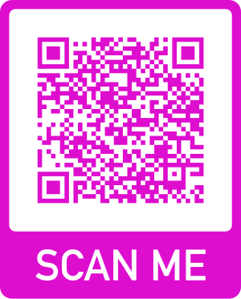
Virtual Schwartz Rounds
Utilizing two facilitators to guide discussion, the sessions have a format where two nurse panelist share their story around a theme to spur discussion between those in attendance.
One-hour sessions held monthly via zoom.
They provide a forum for connecting with peers facing challenging experiences while trying to care for themselves and others.
They are opportunities to share about difficult or uplifting experiences, to offer and to receive support, and to decrease a sense of isolation.
Past Themes
Giving Grace to Yourself
Leading Through the Changing Role of the School Nurse
Navigating Family / Caregivers and Administration Expectations
Celebrating the Micro Moments to Reduce Stress
Hopes for the Upcoming School Year
Upcoming Session
January 19, 2023 at 4pm-5pm
Theme: Hopeful for the New Year:
Creating Positive Intentions
Panelists Needed for 2023

Slide 5
Comments / Data
Love that this session was geared toward school nurses particularly - we can feel so isolated - its so helpful to hear what other school nurses are going through and to receive helpful advice/recommendations on how to deal with similar in our own practice.
VSR Outcomes per Evaluation Forms*
90% As a result of today’s Rounds, I feel less isolated in my work.
82% Today’s Rounds supported my sense of safety.
87% Today’s Rounds supported my sense of calm.
92% Today’s Rounds my sense of connection.
90% Today’s Rounds supported my sense of hope.
94% I felt that today’s Rounds was valuable, overall
* % based on participants that responded with Strongly Agree/Agree
Thank you for the support. I have been contemplating leaving school nursing to retire. But I am hopeful this year will be better as I have learned new skills and am determined to take better self care. I appreciate greatly the support of such programs like this. I now realize more it wasn’t just me, and believe it was a tough time but I still have a lot to offer my students and community.
I so enjoy these Schwartz rounds. As a school nurse I am isolated and this gives me a chance to listen, learn and vocalize.

Slide 6
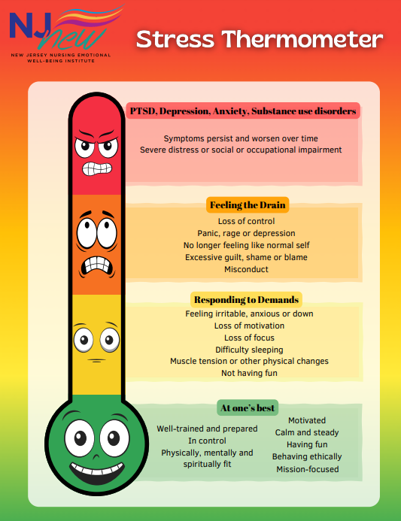
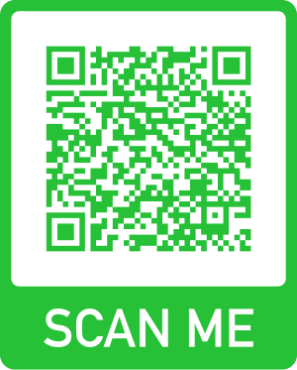
Stress First Aid
Stress First Aid the Trainer (SFA) - an evidenced-based, peer-supported model for organizations to use in providing staff with skills to prevent and respond to stress.
Sponsor nurses to become trainers
Host three 4-hour virtual sessions via zoom
Provide contact hours
Help with Implementation
Upcoming Train the Trainer:
January 4, 6 & 25, 2023

Slide 7
Nurse 2 Nurse Helpline
Nurse2Nurse offers the “ Reciprocal Peer Support model” a national best practice in peer support (APA 2018, DOD 2012)
Data Update: July 1st 2021 – June 30th 2022 -Approximately 2231 calls
The program provides the following services:
Nurse2NurseNJ peer support helpline
Wellness Webinars
Nurse2NurseNJ Network of resources
Self-care activities
Phone - 1.844.687.7301

Slide 8
Well-Being Hub
A state-wide learning collaborative and resource center for individuals and healthcare organizations
Learning collaborative / think tank in developing new interventions
To launch statewide webinars and tool kits targeting resilience development
Online repository
Provide resources for emotional health, support groups, webinars, research and provider

Slide 9
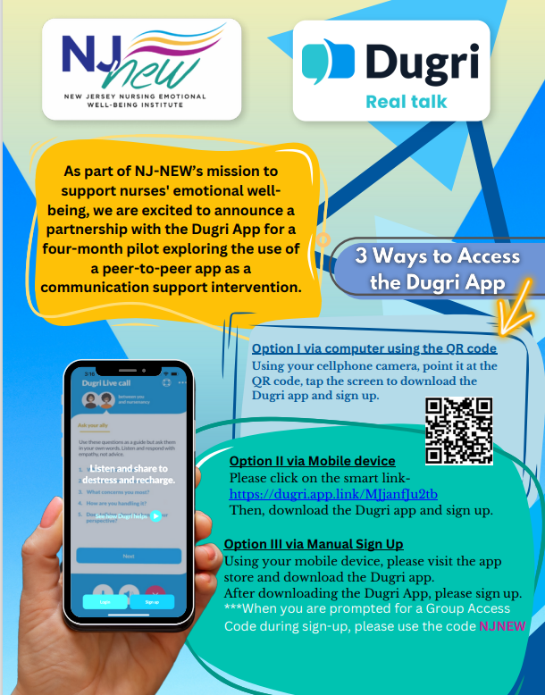
Pilot Peer to Peer App
4-Month Pilot
November 15-March 15, 2023 for
NJ Nurses
The Dugri App is a safe and confidential platform for nurses to share their experiences without judgment or stigma. Through Dugri, you can give or receive support from a peer network of healthcare professionals across the country, 24/7. The Dugri App pilot offers a place to connect with your peers, unload stress, and use “real talk” while remaining anonymous.

Slide 10
Future of Nursing Report 2020-2030 & Nursing Bill

Slide 11
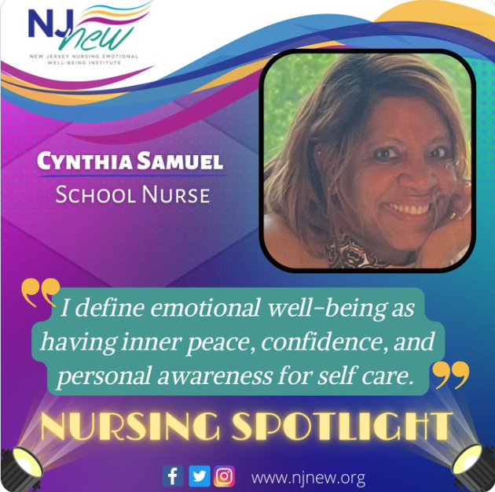
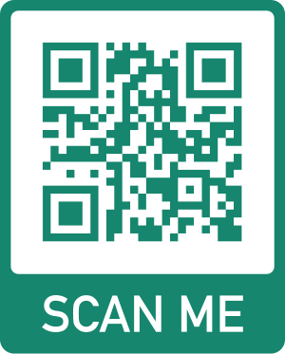
Communications
@NJnew15

