Slide 1
Taking Diabetes to School: Diabetes Management in the School Setting
Ashley Colnett, BSN, RN, CDCES, CSN

Slide 2
Disclosures to Participants
Requirements for Successful Completion: Participants must attend the full activity, complete and submit the program evaluation at the conclusion of the program, and score at least 80% on post test in order to claim CE credit. Your Statement of Credit will be issued upon submission of the evaluation form and successful passing of the post test.
Conflict of Interest (COI) and Financial Relationship Disclosures: Relevant disclosures (or lack thereof) among education activity speakers and planners are as follows:
Speaker/Planner disclosures:
Ashley Colnett, BSN, RN, CDCES, CSN – Certified Pump Trainer contracted with Tandem Diabetes
Disclosure and Mitigation of Relevant Conflicts of Interest: All identified relevant conflicts of interest have been mitigated.
Non-Endorsement of Products: Accredited status does not imply endorsement by NJSNA of any commercial products displayed in conjunction with this educational activity
Off-Label Use:
Participants will be notified by speakers to any product used for a purpose other than that for which it was approved by the FDA, or those that are still under investigational use and not yet FDA approved.
This nursing continuing professional development activity was approved by New Jersey State Nurses Association, an accredited approver by the American Nurses Credentialing Center’s Commission on Accreditation.

Slide 3
Content
Insulin Pumps
Continuous Glucose Monitoring
State Regulations, 504s, IHPs, EHCPs

Slide 4
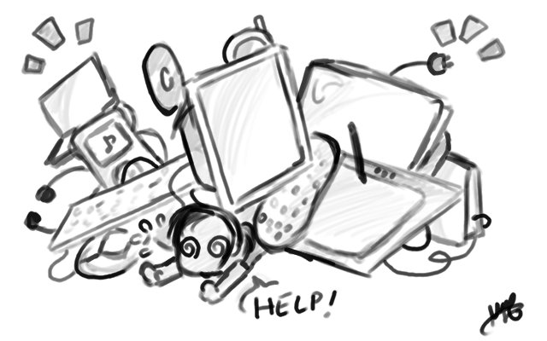
Technology

Slide 5
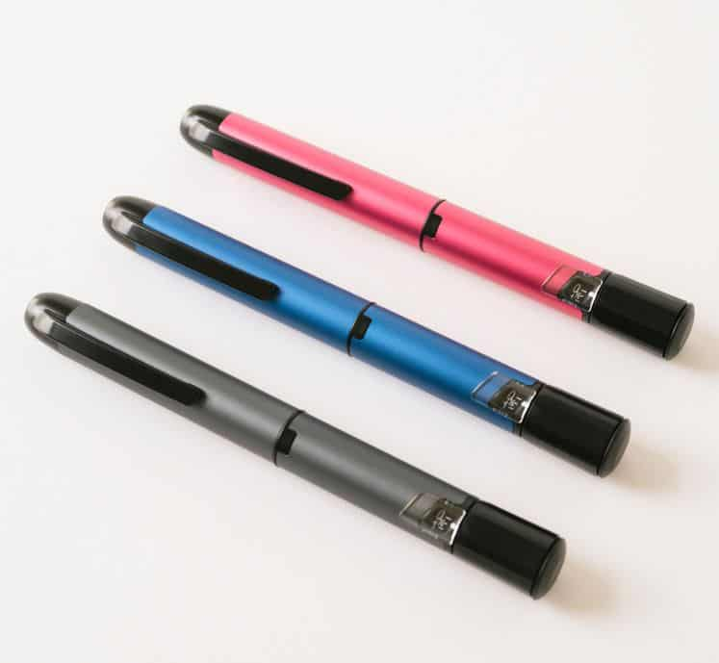
INPEN
First Smart Pen for mealtime/bolus insulin working with a phone app using Bluetooth
½ unit doses
Uses Humalog, Novolog, Fiasp cartridges
Calculates doses like a pump
Can do calculations using a mealtime fixed dose, meal estimation, or carb counting
Temperature gauge and 28 day insulin alert
Shows blood sugars entered, doses of insulin given, and active insulin (IOB)
Can set long acting/basal reminder
Records missed doses
Easy to read reports which can easily be emailed, printed, shared, or faxed through phone
Integrates with Dexcom Clarity and Medtronic Guardian Connect
Uses regular pen needles
“Pump” without the pump

Slide 7
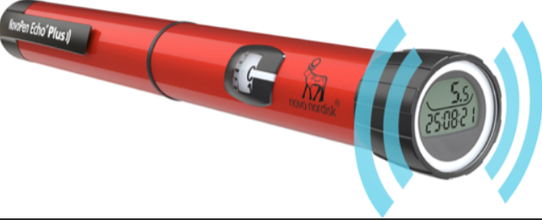
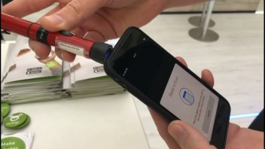
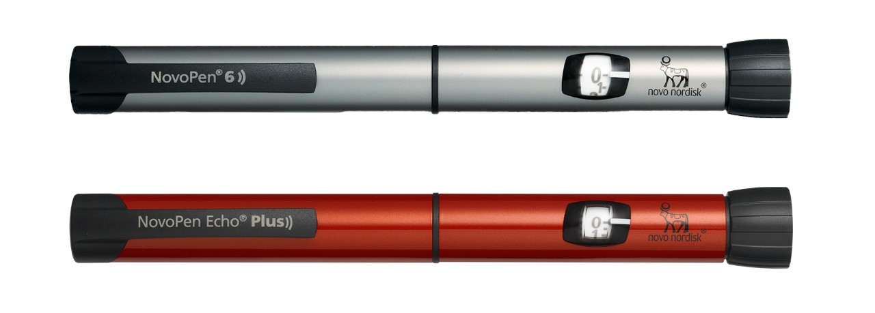
NovoPen 6 & NovoPen Echo Plus
Cartridge pen (Novo products only)
Records when you injected and how many units (on back of dial)
Partner apps: LibreLink, MySugr, Glooko (Dexcom via Glooko)
In some cases can swipe/scan the pen against the phone to transmit the data to the app

Slide 8
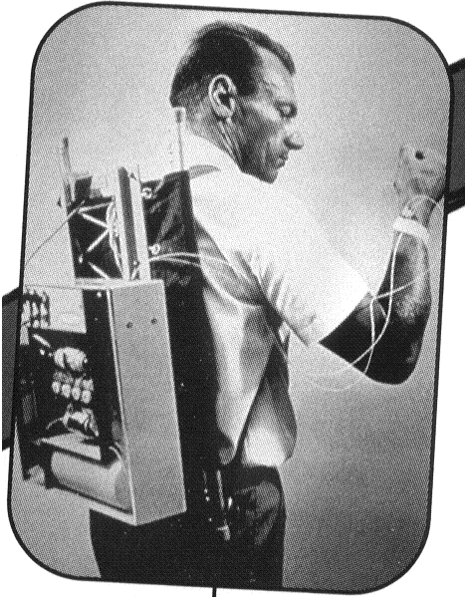
Insulin pumps

Slide 9
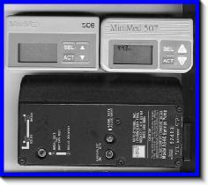
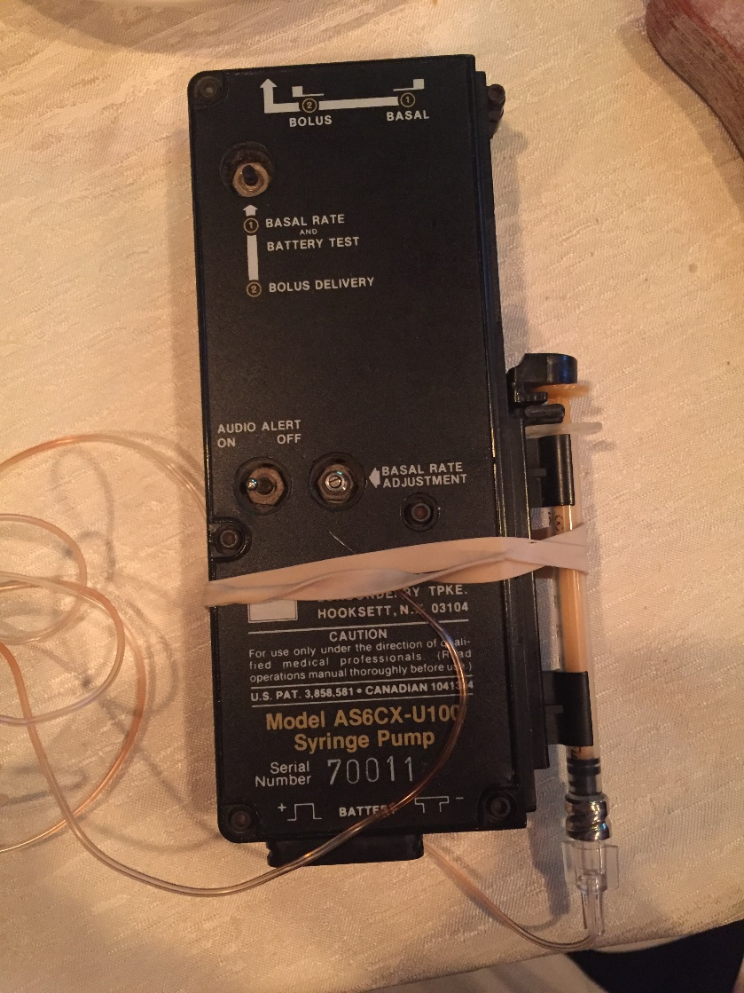
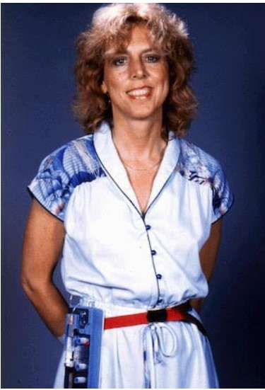

Slide 10
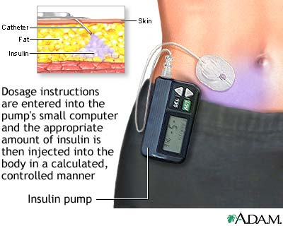
All About Insulin Pumps
Delivers rapid acting insulin through an infusion set
No long-acting insulin
Infusion set is connected to a tiny plastic cannula or small steel needle that is inserted under the skin to deliver insulin on a continuous basis
Infusion sets are changed every 2-3 days
Rapid-acting insulin is drawn up in a reservoir/cartridge
Notes:
All pumps do same basic functions—choosing one is abut what fits for child’s lifestyle and needs, also, insurance plays a factor
Pumps are $8,000-10,000
Each have pros and cons to them—again about child’s needs and lifestyle

Slide 11
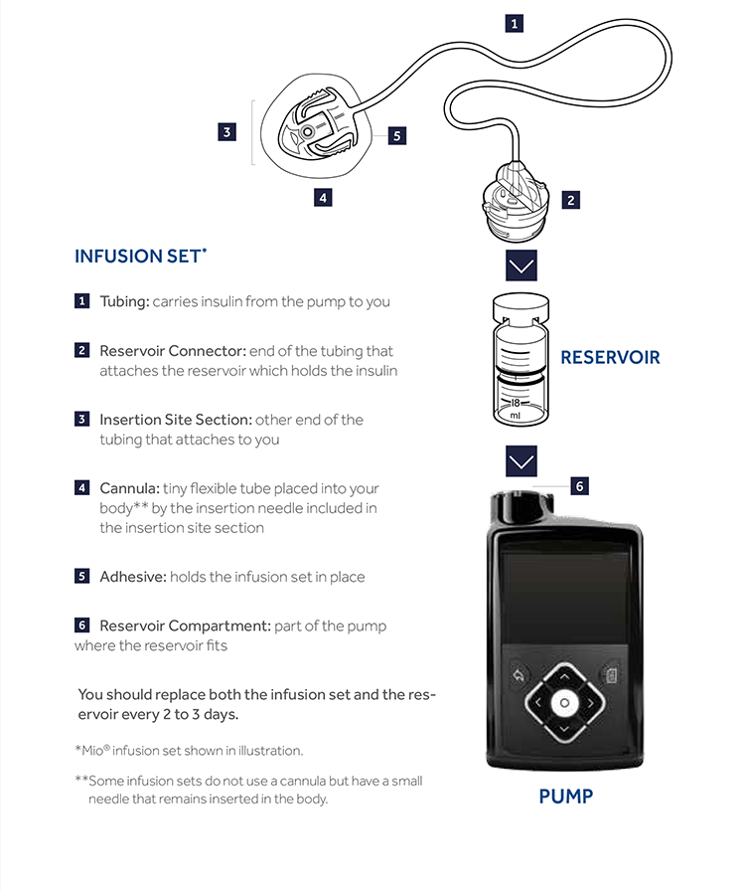
The pump is programmed per physician's orders:
Basal Rates
Insulin to carb ratio
Correction/Sensitivity factor and Target BG
Mimics normal physiologic insulin delivery
Sites worn same areas injections given
Gives insulin continuously over 24 hours – basal rates
Adjustable to different times of day and insulin needs
For meals or high BG can give a dose of insulin – bolus
Uses a “bolus calculator” to calculate the proper dose based on the regimen and the inputted blood sugar and grams of carbs
Battery operated or chargeable
Notes:
Pump has a reservoir for insulin and a microcomputer that allows
for adjustment of the amount of insulin delivered to the patient
Basal rate keep bg in target range – in between meals
Additional doses for increased bg and CHO intake—bolus
Must be able to carb count
This kind of insulin therapy is called IIT (intensive insulin)
Patients get better control on pumps and less hypo events

Slide 12
Closed Loop Pumps (CLPs)
CLP = Closed Loop Pump
A system that works with both a CGM and a pump (integrated—CGM “talks” to the pump)
The pump automatically adjusts the amount of insulin given (both basal and bolus) depending on the specific system algorithm and what the CGM value is
CLPs are fantastic technology, they do a lot in the background to help prevent both highs and lows
Current systems:
Medtronic CLP: Medtronic 670G or 770G with Auto Mode, 780G with Smartguard
Tandem CLP: Tandem t:slim X2 with Control IQ (CIQ)
Omnipod CLP: Omnipod 5 (OP5)

Slide 13
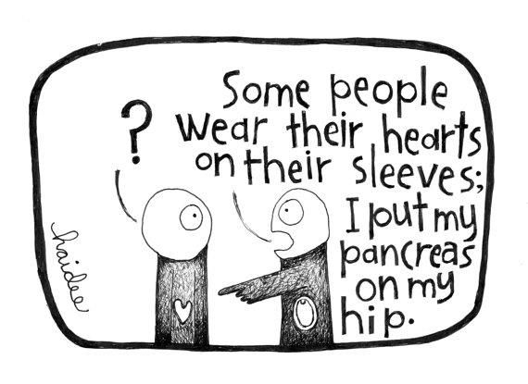
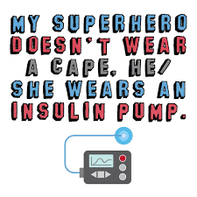
Special Features
Bolus Precision
Small increments for dosing (bolus calculator)
Subtracts from IOB and reverse correction
Bolus Manipulation
Dual Wave/Extended bolus options
Long meals---higher fat, protein & carb content
Pizza, bagels, Chinese, take out
Basal Manipulation & Additional Basal Patterns
Temporary Basal Adjustments
Increase or decrease the administration of basal insulin
Most often used during exercise, illness/steroids, or stress
IOB (insulin on board)
Integrated CGMs
Reminders (missed bolus, BG reminder)
Notes:
Smaller increments of dosing—can get more exact dosing, less rounding, helps to have better control over BG
All have different bolus options—called different things, but idea is the same→ give some insulin now and extend out over time period later (give pizza example)
Basal rates—when give Lantus, in theory it releases equally over 24 hours, but with pump can set exact rates and know how much is being given per hour. Can have up to 24 rates—typically 5-6.
Temporary basal—used for exercise and sports or for illness (cut basal, increase basal)
IOB—again same in all pumps, just called different things. Pump remembers last time bolus given, and if IOB still, subtracts the amount from the recommended bolus. (example of grazing at birthday party or teenage boys eating)
Independence from injections—1 injection every 3 days to insert site, as opposed to minimum of 4 injections a day

Slide 14
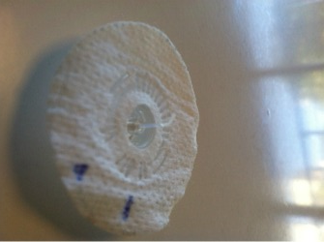
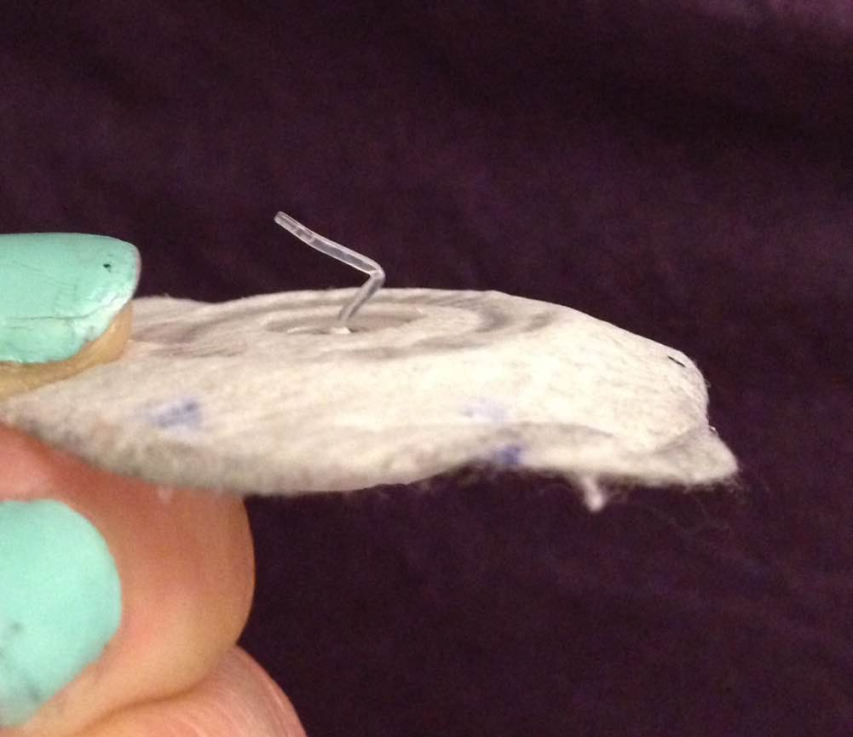
Advantages & Disadvantages of Pump Therapy
Advantages:
Flexibility
Grazing
Less hypoglycemia
Better A1c results, tighter control over BG
Independence from injections
Disadvantages:
Constant connection to a device
Expense
Possible weight gain
Skin infections
Increased risk for DKA- do not have basal insulin on board as backup

Slide 15
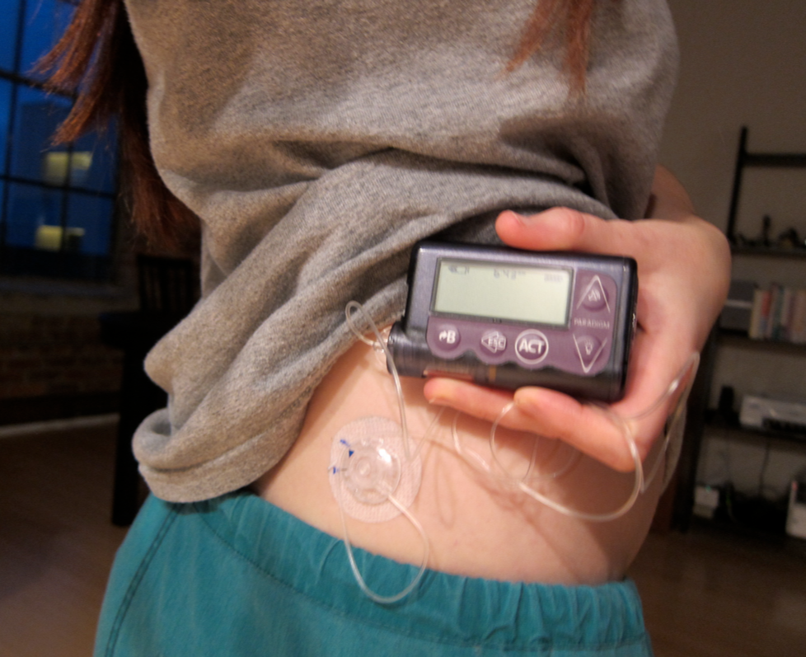
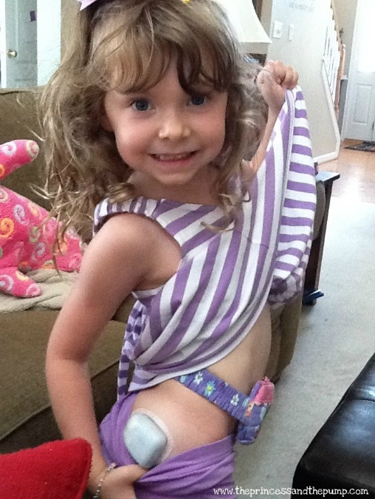
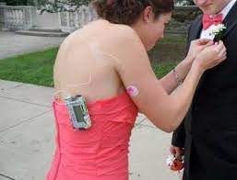

Slide 16
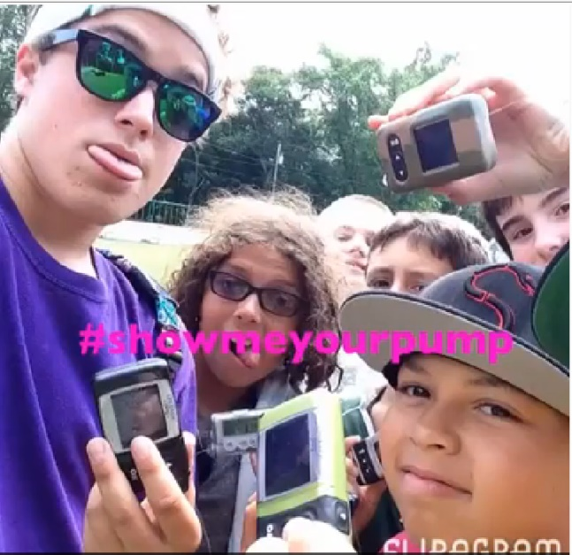
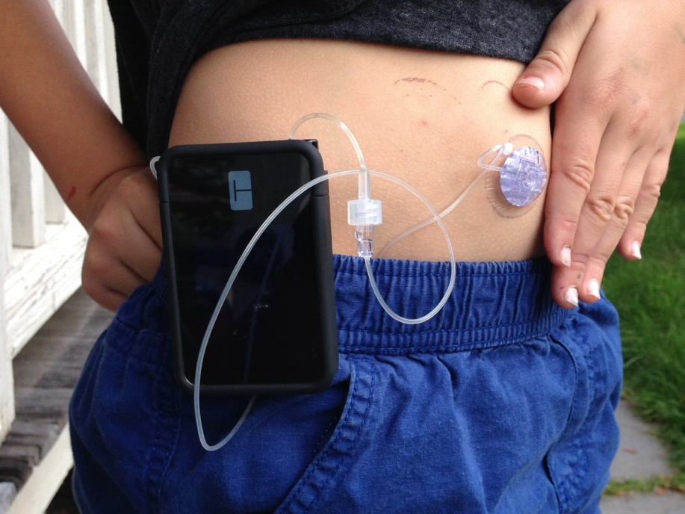
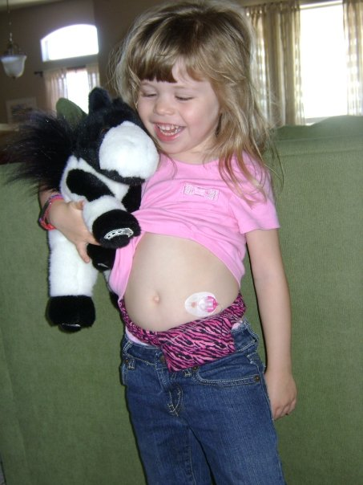
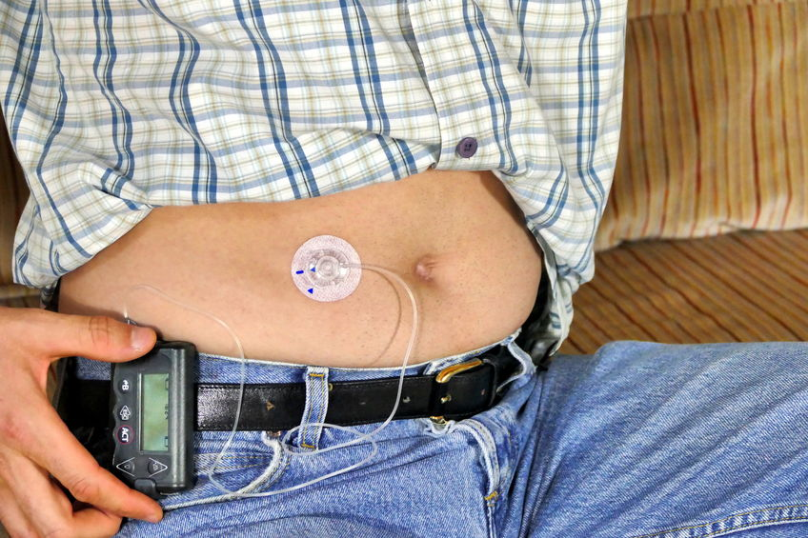

Slide 17
Infusion Sets
A soft, plastic subcutaneous cannula or steel needle inserted at a 90 or 30/45 degree angle by the parent/child
Plastic cannula works like an IV—needle goes in and comes out, leaving cannula in place
An inserter is available for most sets or are incorporated in the set
Some use a steel needle which remains in the subcutaneous tissue
All infusion sets should be changed every 2- 3 days
Can place a site anywhere give an injection
Site rotation is still KEY!
Possible to disconnect from pump without removing the site
Notes:
Each pump company makes their own infusion sets to go with their specific pump
Pick an infusion set based on comfort of how to place it, length of needle, and body mass
90 vs 45 degree angles—kids leaner and more slight, lots of muscle, the 45 works better—90 it hits the muscle and sites tend to fall out more (in my experience). Plus, the 45 angle you can see the cannula under the skin, with 90 you assume it goes in, but it is possible it kinks or bends and then you see unexplained high BG, bc the insulin is not being delivered properly.
Plastic cannula vs steel needle—again based on body mass. In much younger kids they tend to use the steel and for muscular kids, lean, and athletes/gymnasts—better insulin delivery. Plus, steel cannula guaranteed not bent or kinked upon insertion. Also, seen used for kids who are getting lazy changing out their sites bc of steps involved or hate placing it themselves. Note—steel cannulas have been recalled d/t breaking off in kids skin.
Handouts—2 charts comparing sets

Slide 18
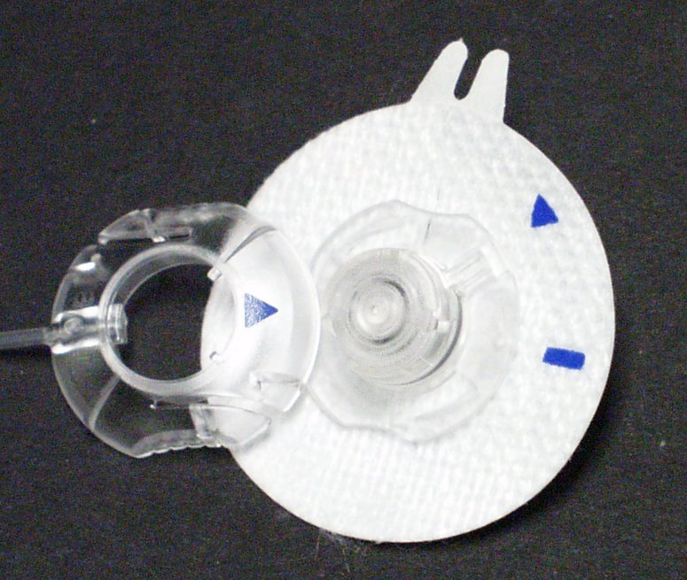
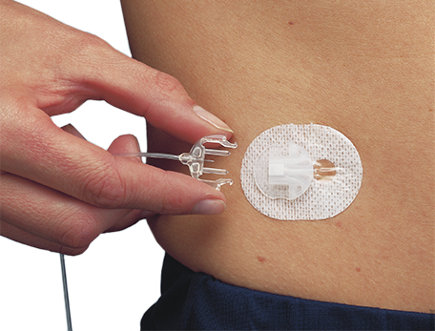
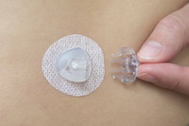
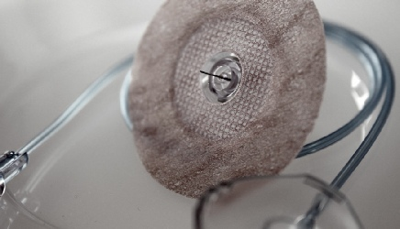
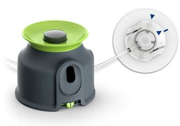

Slide 19
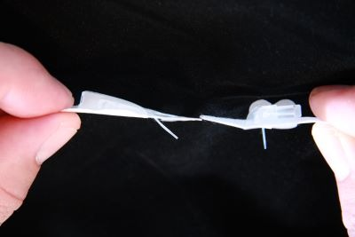
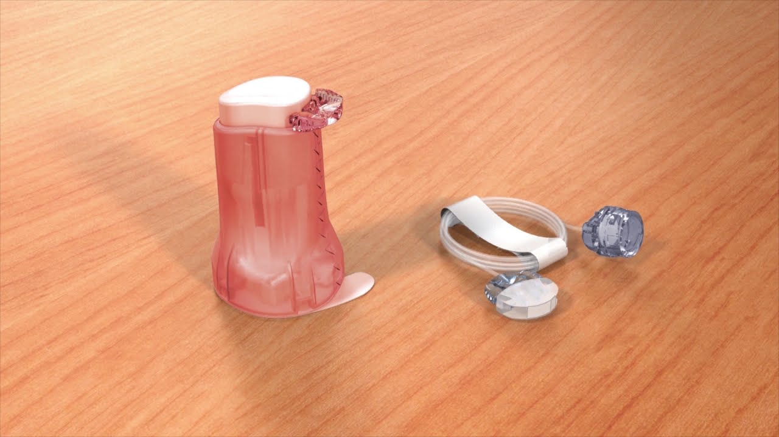
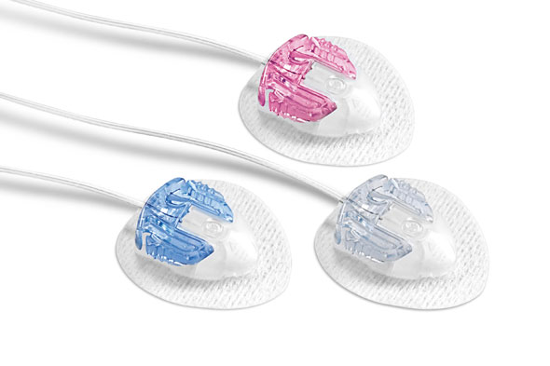

Slide 20
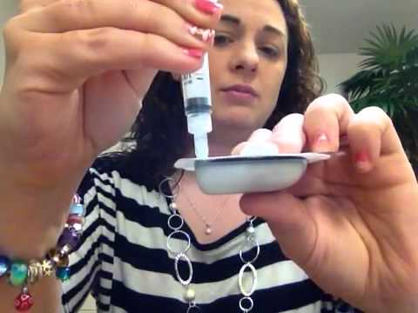
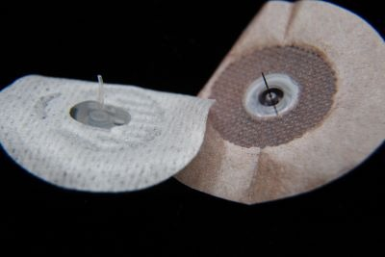
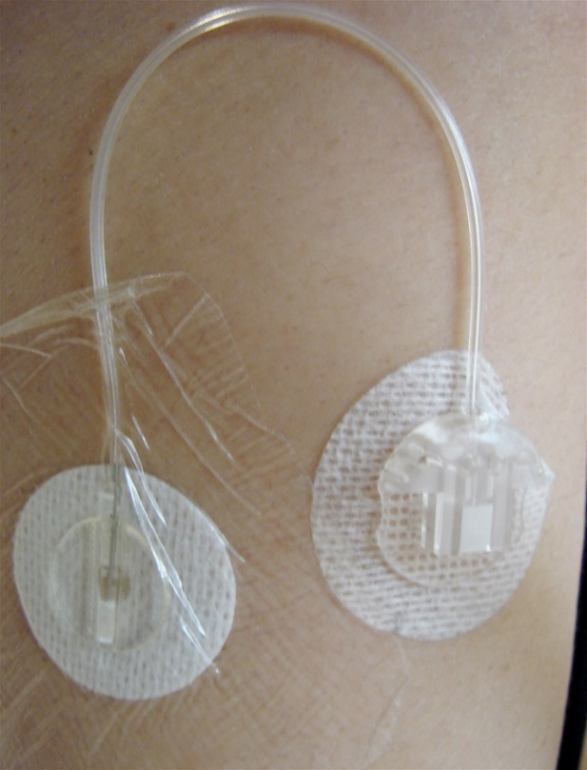
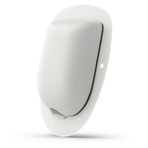

Slide 21
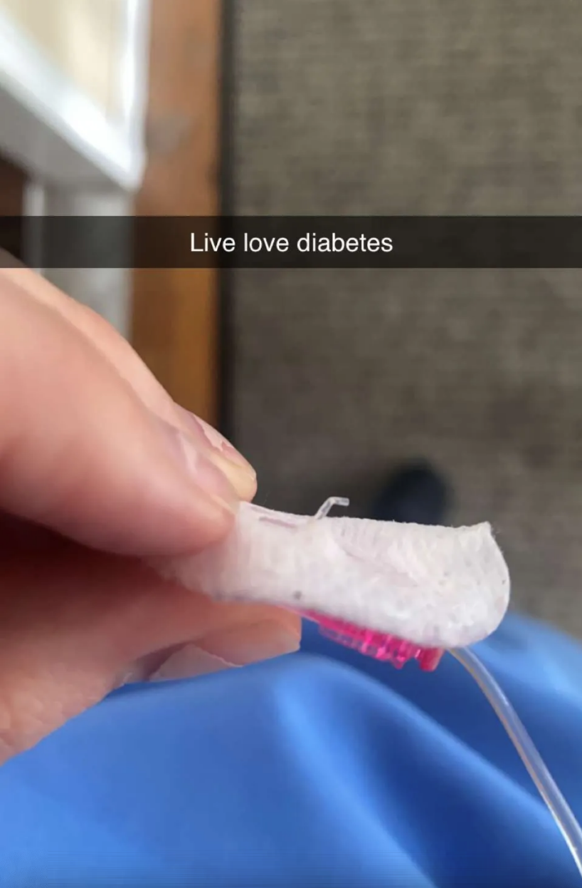
INFUSION SET PROBLEMS ARE THE #1 CAUSE OF UNEXPLAINED HIGH BLOOD SUGARS IN PUMPERS
Notes:
This is the take home message about pumps
If you see unexplained high BG and they’re a pumper, you have to start thinking infusion set.
That’s one of the problems with infusion sets, you’ll hear it termed a “bad site”. Means the site might be bent or kinked under the skin and you don’t know it until you pull it off.
Check your student’s orders for how to handle high BG on a pump. Proper pump protocol is if >300, check ketones, if negative, bolus correction through pump and recheck BG and ketones 1-2 hours. If still high, correct via syringe and change out site. If + ketones, give correction via syringe (so know got the correction), and change out site. Increase fluids, and recheck BG and ketones in 1-2 hours to make sure coming down. This is what they are taught when placed on the pump, but again, you need the orders for school. If not included in your orders, can always call the diabetes team for verbal orders about to handle the situation at school if it happens and what to do.
Examples: Katie at camp

Slide 22
Unexplained High Blood Glucose
If there is an unexplained high blood glucose, above 250-300, ketones should be checked
If negative ketones, a correction bolus should be given via the pump
The blood glucose should be rechecked in 2 hours (goal: 20% reduction)
If the blood glucose has not decreased, or has increased, repeat the correction bolus by injection, change the infusion set
If positive ketones, give a correction by injection immediately (usually higher dose—follow DMMP)
Change infusion set and continue to monitor—recheck BG and ketones q 2 hours
Goal for 20% reduction BG and ketones decreasing
“When in doubt, change it out”

Slide 23
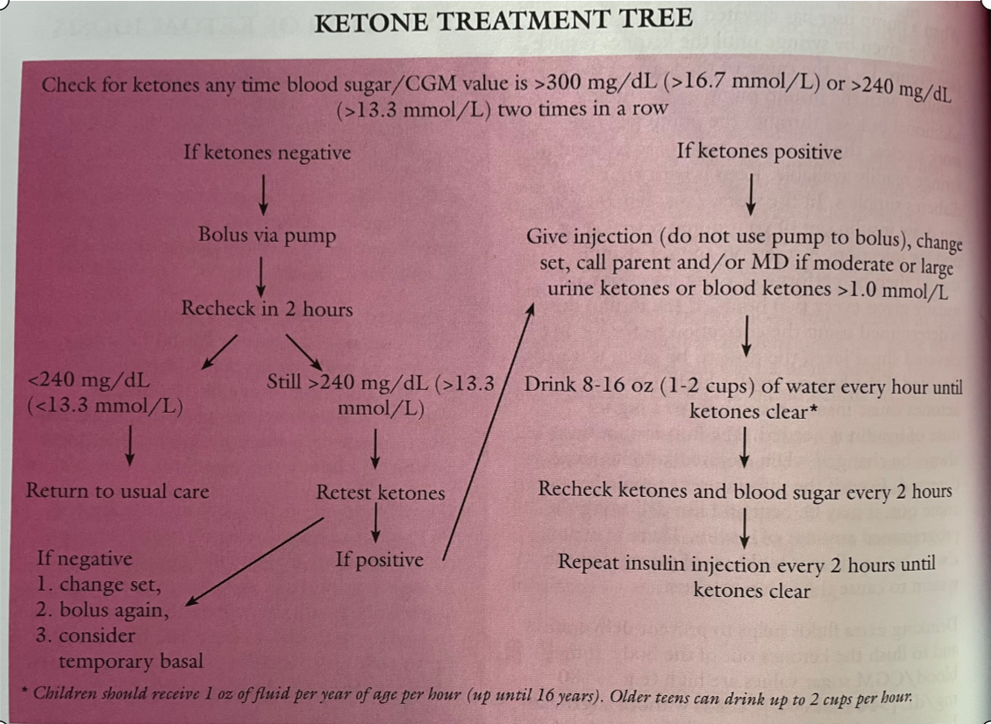

Slide 24
School Pump Supplies
Vial of insulin
2 reservoirs/cartridges – if nurse/student trained on proper insertion technique
2 infusion sets/pods - if nurse/student trained on proper insertion technique
Inserter (if available)
Batteries/charger
Syringes for emergency
Extra dressings (if applicable)
Optional – insulin pen with needles

Slide 25
What School Nurses Need to Know
Risk for DKA
Unexplained high BG? THINK BAD SITE
Should not be off pump for more than 1-2 hours at a time
Can disconnect without removing site
NOT waterproof, only water resistant
Have extra pump supplies at school
Infusion sets, reservoirs/cartridges/pods, batteries, insulin, syringes
Back up insulin in case of pump failure
Long-acting and Novolog/Humalog
Call # in/on all pumps with Customer Service 24/7
All pumps have history screens, can recall all boluses, basals given, and all pump activity
Lower CHO treatment for hypoglycemia on CLPs (5-10gms)
No “free” CHOs on CLPs
Notes:
Risk for DKA bc no long-acting on board. Can get into trouble in few hours on pump if bad pump site or not bolusing.
If unexplained high BG and on pump, have to think bad site. Infusion set problems are the #1 cause of unexplained high BG.
Shouldn’t disconnect for more than 1 hour at a time—no basal being given. Check student’s orders for gym class and keep pump on or off. Contact sports pump should be disconnected. If block scheduling, and gym lasts longer than 1 hour, student will need to check BG after 1 hour, reconnect, possibly bolus to correct a high BG, and then disconnect again. MD needs to specify exercise/gym orders for pump therapy.
Pumps are not waterproof, water resistant—if swimming in school disconnect
Pump failure, will need to give shot of Lantus to cover basals not getting. MD will calculate dose—call diabetes care team for instructions or have MD include orders in DMMP in case of pump failure.
If any pump problems, don’t hesitate to ask student—they live with them 24/7, they know so much. Can always call parent too for guidance. Know the pump companies can walk you through anything over the phone. Customer service rep 24/7, and will stay on phone as long as it takes.
All pumps have hx screens and you can review last bolus given, how much basal given, daily totals, and last site change. It is only a matter of finding the correct screen on each pump.
School nurses are not expected to be experts on their student’s pump. If you’re interested in additional training for your student’s pump, reach out to their endo office and see if any CDEs can schedule training for you or if they have pump company reps who can.

Slide 26
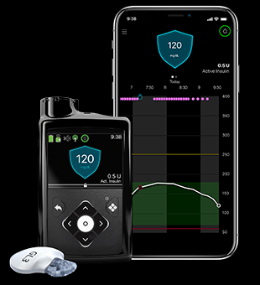
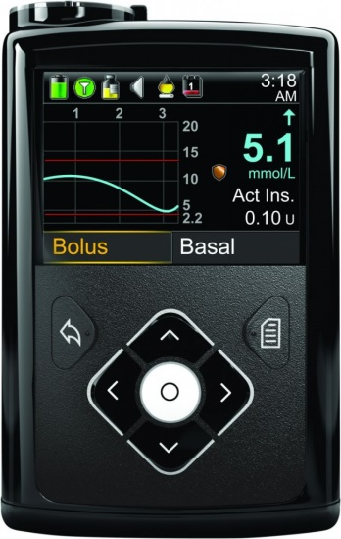
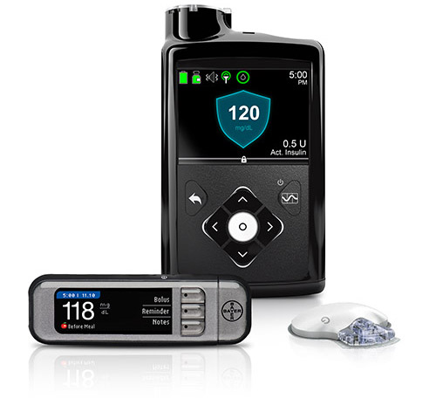
Medtronic: 630G, 670G, 770G, 780G

Slide 27
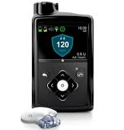
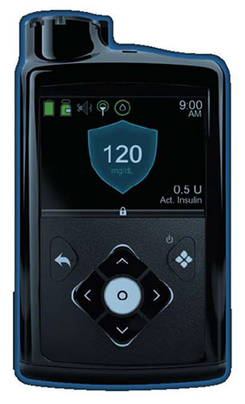
How to tell which is which
670G
630G
770G/780G

Slide 28
Medtronic 630G & 670G
First hybrid closed loop (HCL) pump released in US in March 2017
Uses Guardian 3 CGM (5-7 day wear)
3 modes of operation
Manual Mode – acts like regular pump
Suspend before low (SBL) – when used with Medtronic Guardian CGM – if algorithm predicts low within 30 minutes, pump will suspend basal insulin until glucose begins to rise
Auto Mode (670G) – pump looks at q5 minute CGM readings and rather than giving basal insulin, administers micro-boluses, every 5 minutes based on trends of glucose (present, past, direction & speed of movement of BG)

Slide 29
670G Auto Mode
Glucose target is 120 mg/dL
A temporary target of 150 mg/dL can be set for activity
Must calibrate CGM daily
2 calibrations when in Manual Mode
3-4 calibrations when in Auto Mode
Carbs must be counted and entered
Must pre-meal bolus!
Pump recommendations for carbs and BG cannot be altered
Still not the artificial pancreas

Slide 30
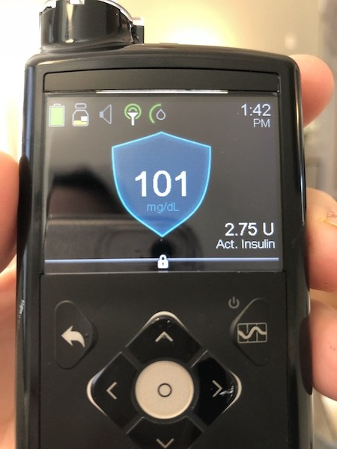
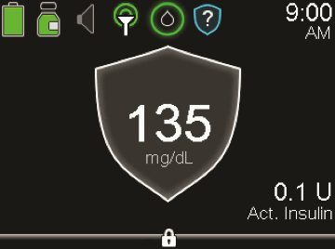
670G Auto Mode
If glucose is high for 4 hours, a calibration must be done or pump enters “Safe Basal”
If glucose is low for 2.5 hours, a calibration must be done or pump enters “Safe Basal”
“Safe Basal” is a calculated rate based on the present glucose as well as the trend of the glucose. Lasts for 90 minutes, then pump reverts to Manual Mode if not calibrated/fixed.
Can get kicked out of Auto Mode for various reasons—look at shield on home screen

Slide 31
Medtronic 770G
Uses Guardian 3 Sensor and Guardian Link 3 Transmitter (updated transmitter)
Still has 3 modes: Manual, SBL, Auto Mode (all function the same as previous series)
Requires 2-3 calibrations a day
5-7 day wear on sensor
Bluetooth enabled – phone app shows pump screen and connects continuously to CareLink upload
Has follow feature
Enabled for software upgrades

Slide 32
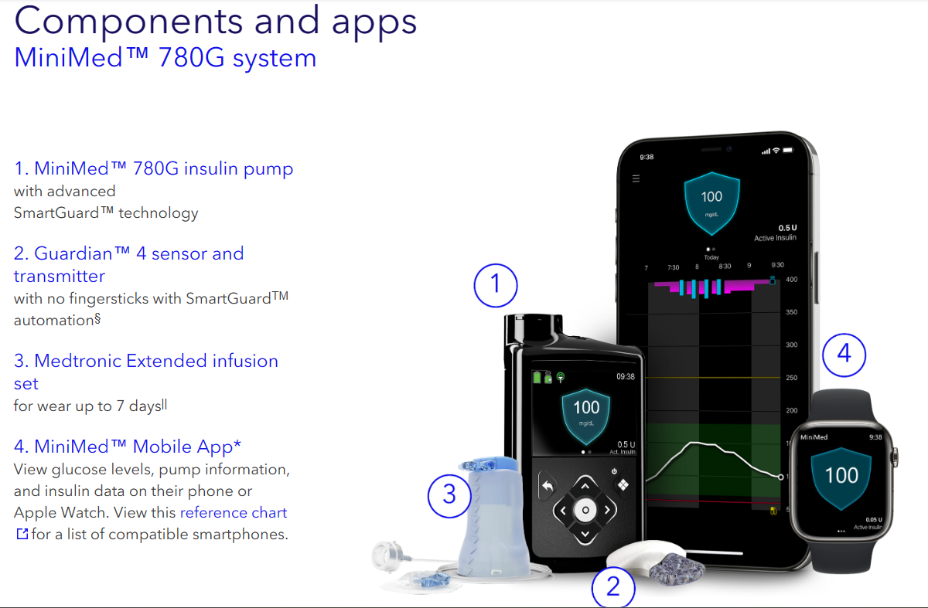
Medtronic 780G
Approved 4/21/23
New algorithm (3 parts)—fights to keep in SmartGuard more, less kickouts
Automated Basal
Auto corrections
Meal Detection Technology
Fewer alarms, simpler operation (extended periods for all kickout features)
Adjustable target glucose as low as 100 mg/dL (lowest on the market)
New CGM: Guardian 4 sensor & transmitter (MARD 10.4%)
New 7 day wear infusion set
1 calibration on first day to enter SmartGuard, then 0 calibrations after (except in Manual Mode)
Replaces fingersticks and can dose off CGM (in SmartGuard only)
Automatic corrections when parameters met (auto corrections q 5 mins, no limit)
Software update capability
Mobile app (view data, upload wirelessly)

Slide 34
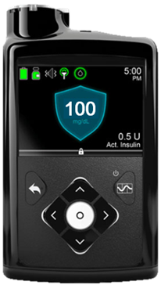
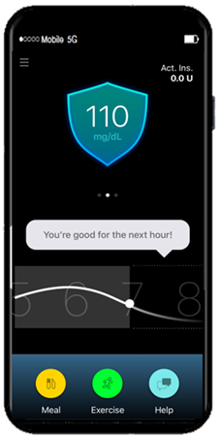
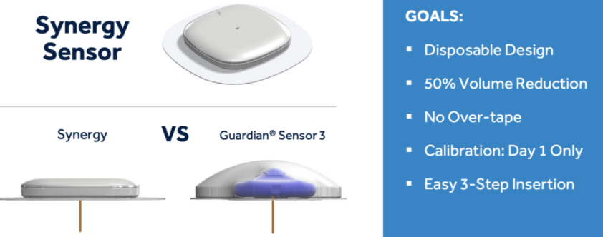
Medtronic Personalized Closed Loop System
Adapts to physiology and behavior
Automated meal handling
100% Auto Mode capable
50% smaller disposable CGM (Simplera)
Simplera submitted for CE Mark in Europe; holding off for FDA submission until 780G and Guardian 4 approved
10 second sensor insertion
Smartphone Control

Slide 35
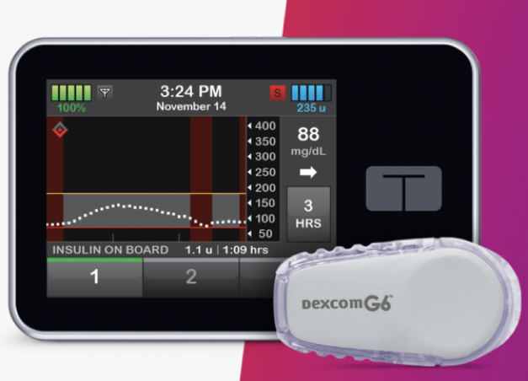
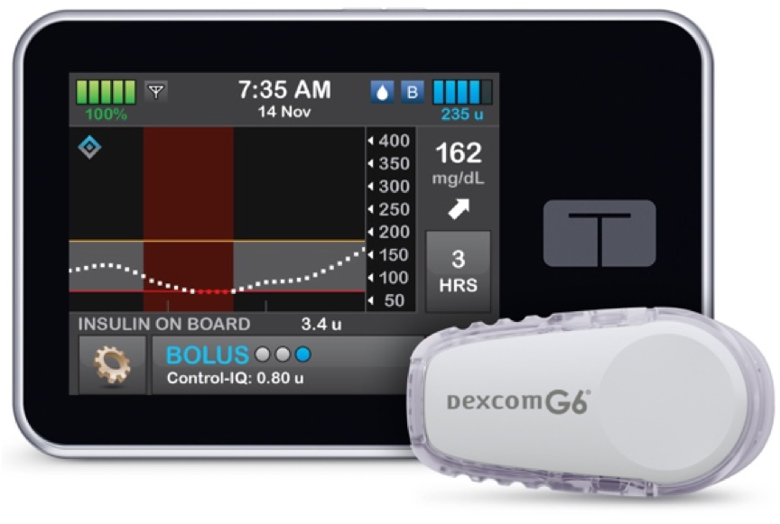
Tandem t:slim x2 Basal IQ & Control IQ

Slide 36
Tandem t:slim x2
First touch screen and rechargeable pump
Released 2016
Software is upgradeable via computer connection
First pump capable of receiving software upgrades
Holds 300 units of insulin via cartridge
2 software formats: Basal IQ or Control IQ

Slide 37
Tandem t:slim x2 Basal IQ

Slide 38
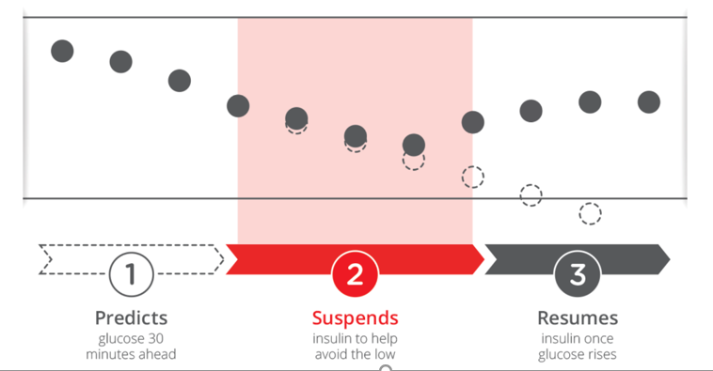
Basal IQ
Pump has an algorithm using Dexcom G6 to predict lows
Integrated with Dexcom G6
Uses real time sensor data and predicts glucose 30 minutes ahead
Will suspend basal insulin if BG is <70 OR predicted to be <80 in next 30 minutes
Assesses in 5 minute increments
Turns back on once predicted BG is rising

Slide 39
Tandem t:slim x2 Control IQ

Slide 41
t:connect Mobile App
All Tandem x2 pumps have the ability to connect via Bluetooth to phone app
App provides viewer with pump home screen info, Dexcom G6 readings and graph, IOB, and all current Status info
Uploads wirelessly to t:connect and can be connected to HCP office
Pump alerts/alarms sent as notifications on phone
Can bolus from phone app!

Slide 42
Tandem Mobi Pump
½ the size of x2
Holds 200 units
5 inch tubing connects to regular infusion sets
No screen, controlled on phone app
Will integrate Dexcom G6 and CIQ
More personalized CIQ settings (exercise)
Commercially available 2024

Slide 43
Tandem Mobi Pump

Slide 44
Tandem Pipeline

Slide 45
Tandem Pipeline

Slide 46
Omnipod: Eros, DASH, OP5

Slide 47
Omnipod
Only tubeless pump
Both systems use PDM (Personal Diabetes Manager) that controls pod
Pod changed q 2-3 days, waterproof
Pod holds 200 units
Pod=pump and functions same as other pumps (basal rates, bolus via PDM)
Easier fill process, PDM primes and inserts cannula
PDM can deliver bolus as long as within 5-6 feet
Neither system currently CGM integrated
Many podders use Dexcom independently of pump on their phone so they can still get CGM alerts

Slide 48
Omnipod DASH
DASH PDM is touch screen and Bluetooth technology, WiFi enabled
PDM is “locked down” Android phone (cannot text/call, download apps)
WiFi – will allow software updates
“View” app for caregivers – will allow remote monitoring (cannot bolus remotely)
“Display” app on phone allows to view current status
Built in CalorieKing food library with insertion of carbs into carb calculator accessible in bolus calculator

Slide 49
Omnipod 5 (OP5)
OmniPod’s HCL system—FDA approved January 2022
Age 2 years and older
Integrated with Dexcom G6
New pods and controller (no longer PDM)
Set for full control on mobile app (remote bolusing)—Android only right now, working on Apple version
2 modes: Automated Mode and Manual Mode
Every 5 minutes, SmartAdjust™ technology receives a CGM value and predicts where the BG will be in 60 minutes into the future
Then, increases, decreases, or pauses automated insulin delivery based on target set in pump
Adjustable target 110-150, can adjust by time of day
Exercise feature called “HypoProtect”—allows temp target set at 150 and restricts insulin delivery
Built in SMART Bolus calculator that is informed by BG and trends
Cannot get “kicked out” of Automated Mode (Limited Mode)
Algorithm updates after each pod change (takes few weeks to learn person and become more aggressive)

Slide 52
Beta Bionics

Slide 53
iLet Bionic Pancreas Pump
Approved 5/19/23
Age 6 and up for T1D
HCL system integrated with Dexcom G6
iLet ACE pump and iLet Decision Dosing software
Only need to enter body weight (no carb ratio, sensitivity factor, basal rates, etc.) and “Go Bionic”
NO carb counting!
Determines 100% of all insulin doses
No corrections, no calculating boluses
For dosing, users enter desired glucose target (usual, lower, or higher), the type of meal (breakfast, lunch, dinner), and the size of the meal (usual, less, or more)—”meal announcements”
Adapt over time to respond to the users’ individual insulin needs
“iLet Dosing Decision Software, allows it to independently determine and command increase, decrease, continued maintenance, or suspension of all basal insulin doses”

Slide 54
iLet Bihormonal Bionic Pancreas Pump
Presented at ATTD (Advanced Technologies and Treatments for Diabetes) April 2022
Currently in pivotal clinical trial phases—not FDA approved
FULLY CL system—insulin AND glucagon chambers (Zegalogue liquid stable glucagon)
Dual chamber—glass insulin cartridges
Like the iLet BP:
Fully autonomous—enter weight to begin
No insulin regimen parameters
NO carb counting
Don’t have to determine bolus insulin for correction doses
Adapts autonomously and continuously to meet users’ insulin needs
Cannot change insulin doses
Algorithm works to automate insulin AND glucagon doses
Clinical trial results shown at ATTD were promising!
No increase in hypo events, more TIR, lower A1c

Slide 55
“Looping”—OpenAPS or Loop
NOT FDA approved; DIY
Technology created by those “We Are Not Waiting” Community
Open Loop system using app (OpenAPS or Loop)--instructions for building a phone app are available online (hacked into old Medtronic pump or Omnipod Eros or DASH)
Dexcom information is sent to the app
Basal rates, carb ratio, CF, and targets are entered into the app

Slide 56
A Riley Link or Raspberry Pi is purchased to hack the pump
Based on the glucose reading, the app controls the basal insulin
When bolusing for food, the user enters their glucose and carb count into the app, as well as they type of food (quick carb, more complex carb, or foods like pizza)
The app makes a recommendation which the user can then agree with and the dose is sent to the pump via Riley Link or Raspberry Pi
This is an ongoing process, which is continually upgraded as new information and software is developed

Slide 57
NEW Tidepool Loop 3:
No longer Apple/Mac only! Can use PC with browser build
If using DASH pods, NO Riley Link required

Slide 59
Tidepool Loop
FDA approved 1/24/23
Technology created by those “We Are Not Waiting” Community
Started as Open Loop system using Loop app and Riley Link (DIY)
“first automated insulin dosing app”
Approved 6 years and older
Target range 87-180
iOS only right now (recent funding secured for Android)
Next steps: in discussions with major insulin pump and CGM companies to discuss interoperability (existing partnership with Dexcom already)
Goal is for users to use app on devices of their choosing
First AID app that can be controlled directly from an Apple Watch

Slide 60
Tidepool Loop Algorithm
“pre-meal preset” mode, allows users to customize their desired glucose range around a meal
Uses different food emojis to indicate different amounts of carbohydrates. (Lollipop emoji for a small amount of fast-acting carbs for a 30-minute bolus of insulin, a taco for snacks and most meals for a 3-hour bolus, or a pizza for a larger meal with a longer extended 5-hour bolus)
Tidepool Loop system itself does not come with a CGM and insulin pump – it is an AID algorithm that can operate a CGM and insulin pump through the mobile app.
In other words, the CGM gets the necessary information, Tidepool Loop is the brains, and the pump administers insulin.
Will no longer need to hack or jailbreak older pumps. Instead, will have partnerships with device companies and algorithm built into devices.
No timeframe yet for launch

Slide 61
Continuous Glucose Monitoring

Slide 62
What is CGM?
A sensor (thin filament) that measures the glucose level of interstitial fluid under the skin
Measures interstitial fluid glucose levels every 1-5 minutes/24 hours a day while worn (288+ BGs a day!)
May or may not have alarms
Used to identify trends and patterns of glucose fluctuations
Some are approved to replace fingersticks (Dexcom G6 & G7/Freestyle Libre 2, Libre 3)
Blood sugars shown on a screen of pump, phone, or receiver, as a number and/or graph
Arrows show direction and speed blood sugars are moving
Approved to wear sensor 7 – 180 days, depending on the brand
Alerts can be set to notify wearer of low or high blood sugars on some models
Types:
Medtronic Guardian Connect, Guardian 3 & Guardian 4
Dexcom G6 & G7
Freestyle Libre 2, Libre 3
Eversense & Eversense E3

Slide 63
Notes:
Graph shows how sensor shows where BG is between fingersticks. Breakfast and lunch #s look good, assume BG stable in between, but sensor shows it was not. Seeing things like this and correcting them is how ppl get tighter control on their numbers and improve A1c.

Slide 65
Medtronic Guardian Connect
Uses smart technology to predict where glucoses are headed
Alerts 10 - 60 minutes before a glucose excursion
Bluetooth reads to a phone app
5-7 day wear
Need to charge transmitter
Needs 2 calibrations per day
Automatically uploads to CareLink system
Has “follow” capabilities

Slide 66
Notes:
CGMs—Enlite/Guardian for Medtronic and Dexcom G5

Slide 67
Guardian 3 or GL3
Works with ALL Medtronic pumps (L for Link for 770G & 780G)
Stand alone CGM system called Guardian Connect (still uses Guardian 3 sensor/transmitter)
5-7 day wear
Must be taped properly
Calibrated 3-4x/day
Not approved to dose off value
Charge transmitter
Guardian 4
Only works with Medtronic 780G pump
5-7 day wear
Must be taped properly
No fingersticks IF in SmartGuard
Calibration needed to first enter SmartGuard
Approved to dose off value in SmartGuard ONLY
Calibrations required in Manual Mode
Charge transmitter
Guardian 3
(630G, 670G)
Guardian 3 Link (770G, 780G)
Guardian 4
(780G)
Guardian Connect (CGM system)

Slide 68
Dexcom G6 & G7

Slide 69
Dexcom G6
Customizable alarms can be turned on and off
Predicted Urgent Low alarm (under 55 in 20 mins)
No calibrations
Replaces fingersticks
Approved to dose off of
10 day wear
No charging transmitter (battery for 90 days)
Easy insertion device--one step
Works with many cell phone models, Apple watches, receiver
Data can be shared (Dexcom Follow/Share)
Live alarm sharing
Dexcom Clarity app on phone or Clarity online
Siri will verbally give blood sugar reading on iPhones
For visually impaired, connect to Sugarmate app on phone and then enable Sugarmate Skill on Alexa to ask what BG is
Integrated with Tandem x2 pumps and Omnipod 5

Slide 71
Dexcom G7
Launched 2/17/23!
2 years and older; approved for pregnancy
MARD 8.1% adults, 8.2% pediatrics (vs 9% G6)
Extended wear: 14-15 days? (future)
12-hour grace period to replace finished sensors
Sensor/transmitter 1 piece—dispose whole unit after wear (60% smaller!)
Faster sensor warm up time—30 mins vs 2 hours
No calibrations
Replace fingersticks/Make dosing decisions
Approval for wear of back of arm (better accuracy)
90 degree insertion—less trauma/better accuracy
More alert options
Smartphone app or receiver
Will integrate with Tandem (Summer) and OP5 (Fall)

Slide 73
Libre 2
Has high and low alarms, but no automatic display/real time
Still have to scan sensor to see BG
Receiver and phone app
Receiver is Blue in color and says Libre 2
Downloads to LibreView account (automatic by app)
Approved ages 4 years and up
Improved accuracy vs original Libre
Same price as original Libre (much more affordable than Dexcom)
14 day wear, back of arm only
Sensor and transmitter 1 piece—disposable
No calibrations, replaces fingersticks, can dose off of
>500mg Vitamin C will give false high readings
March 2023 approval for pregnancy and integration with AID systems (aka pumps)
Sharing capability
Text to talk feature on app
‘Check Glucose’ symbol for rapidly changing BG

Slide 75
Libre 3
MARD 7.9% overall (8.9% with different testing*); L2 was >9%
Approved ages 4 and older
14 day wear, back of arm
No calibrations
Replaces fingersticks
Much smaller! 2 stacked pennies
Smallest and thinnest available on market
Real time readings—no more scanning!
Customizable alarms
Data transmitted to smartphone every 60 seconds (Libre 3 app or reader)
Same price as previous versions
33 feet Bluetooth span (vs 20 feet with others)
Still 1 piece applicator and all in 1 sensor/transmitter (new applicator)
March 2023 approval for pregnancy and integration with AID systems (aka pumps)
Notes:
Add notes from Brian about upcoming pipeline

Slide 77
Eversense
First implantable sensor
Worn for 3 months-90 days (may or may not be removed after use)
Inserted in upper arm via incision, using local anesthesia
Removable, rechargeable transmitter must be worn
Reads to mobile devices
Vibrates on the arm when alarming, even if not near mobile device
Requires 2 finger stick calibrations a day
NOT approved for insulin dosing
Provider needs to be trained on insertion

Slide 79
Eversense E3 (Senseonics)
FDA approved February 2022 (was already in Europe--XL)
18 y/o+
180 day implant (6 months)
MARD 8.5%
3 phases of calibration (24 hours, 21 days, daily)
Initial 24 hour warmup phase
Eversense app
Real time readings and alarms
Vibrates on the arm for alerts
Implanted sensor and rechargeable transmitter
Can share data with others—5 people
Eversense - Future
365 implantable wear

Slide 81
There’s an App For That…Demos!
MiniMed Virtual Pumps
Omnipod 5 Simulator
t:simulator
*Not simulators
Dexcom G6 Simulator
iLet simulator website:
Beta Bionics iLet Simulator (deploy-react-simapp.s3-website.us-east-2.amazonaws.com)
FreeStyle Libre 2 & 3

Slide 82
Check Out Company Websites!
All manufacturer websites have:
full User Guides as PDFs
Medtronic has specific School Nurse Guides!
Quick Reference Sheets/Guides
YouTube videos
Tutorials
FAQs
Plus, 24/7 Tech Support phone #s!
Medtronic: https://www.medtronicdiabetes.com/download-library
Tandem: https://www.tandemdiabetes.com/providers/education-and-resources/training
Omnipod: https://www.omnipod.com/current-podders/resources
Beta Bionics: https://www.betabionics.com/resources/
Dexcom: https://www.dexcom.com/en-us/guides
Libre: https://www.freestyle.abbott/us-en/support.html
Other:
Panther Program: https://www.pantherprogram.org/
DiabetesWisePro: https://pro.diabeteswise.org/devices/device-library
ADA Consumer Guide: https://consumerguide.diabetes.org/

Slide 83
State regulations and laws

Slide 84
State Regulations/Laws for Diabetes Care in the School
N.J.A.C. 6A:Chapter 16
N.J.S.A. 18A:40-12.11-21
Lists specific requirements for schools
http://www.state.nj.us/education/edsupport/diabetes/careppt.pdf
NJDOE Website
http://www.state.nj.us/education/edsupport/diabetes/
Notes:
legal issues and liability—what are we legally responsible for and what are we liable for?
Chapter 16—all aware, defines health services, school nurse, etc
NJSA—Education Statutes, Chapter 18A:40-12.11-21 deals specifically with diabetes and lists requirements of schools. Did you know this existed? Following website is a PP from NJDOE on the statutes themselves. If go to website listed, can find these and read each one individually. Discusses health care plans, students managing their diabetes, glucagon delegation, and more.
NJDOE website—has an entire page devoted to diabetes care in school

Slide 85
https://www.nj.gov/education/edsupport/diabetes/
Notes:
First arrow—leads to PP with statutes
Second arrow is FAQ about the law and statutes. Included in handouts.
Third arrow is sample MD orders (DMMP) and sample IHP

Slide 86
Notes:
From NJDOE PP on the law. These are the requirements.

Slide 90
Notes:
Issues in school: student checking BG outside of HO (in classroom, lunch room, etc), MD orders should reflect if student can perform tasks independently and that they are SAFE to do this.
My student, MD office wouldn’t sign off on it. Subbed in school where kids were allowed and they would call SN from classroom and report their numbers.
Also addresses if can give themselves insulin injections. Most orders read if they can do independently, with assistance, or cannot do on their own. Even if can do independently, still nursing responsibility to oversee management and ensure done properly.
Teachers and staff tend to be upset about potential needle exposure and blood exposure. Law requires that student dispose of all items safely and appropriately. (Story of student sticking kids with pen needle) If allowed to do tasks outside of HO, arrange area for sharps container and discuss with student how they are going to perform these tasks safely. Explain if they don’t can’t allow them to do outside of HO. Review with student proper procedures for safe disposal.

Slide 91
Notes:
If student is older and handling a lot of their management, want to address in IHP how the SN is going to be involved in ensuring care is being done properly. As we all know, CYA. Ultimately, it’s our license, so we are responsible to know they are doing it correctly.
Ideas: students record their info in log book in HO, including outside of HO testing times, all insulin given, if treating any lows, etc. student can pull up history screen on pump to verify everything.
These tend to be bigger challenges for HS students d/t schedules, # of students SN has to care for, and more independent, large size of school and distance to get to HO

Slide 93
https://diabetes.org/tools-support/know-your-rights/safe-at-school-state-laws

Slide 94
504, ihp, ehcp, and DMMP

Slide 95
504s, & IHPs, & EHCPs…oh my!
NJ state law requires each student with diabetes to have IHP and EHCP
Updated each school year
Based off of DMMP/MD orders
Procedure guidelines and directions for student’s care while in school
Parent should have opportunity to review and sign
IHP more details, EHCP addresses emergencies (typically high and low BGs, plans for when CSN not on grounds, and evacuations and lockdowns)
504 Plan
Updated each school year
Should have—for student’s protection
CSN should be on committee
Outlines accommodations for student
Notes:
I always had my parent review the IHP and EHCP I developed and sign and date it. Always included list of names of all staff getting plan so parent was aware how many staff members going to—signature indicated they were aware of that. Tried to do this in August before school started so was in place for September (and not trying to be done during the crazed month of September). Would call parent over summer and try to schedule meeting before school year to accomplish all this.
504—SN should be on committee as they have the medical knowledge and can suggest accommodations
DMMP—school orders from MD, sample plan on NJDOE website. Typically, endo practices have their own set of orders, and provide them to students to give to schools. These orders are the basis for your care for the student, and then can use as guide for developing the IHP and EHCP. I always remind parents, if changes to student’s ratios, doses, etc they need to get updated set of orders/plan while at appt and give to SN.

Slide 98
http://main.diabetes.org/dorg/PDFs/Advocacy/Discrimination/504-plan.pdf
Notes:
Also, for state testing, students should be placed in pull out groups with special accommodations. This allows them to have breaks and leave testing for highs and lows. It eliminates that section of the test and doesn’t count in their scores.
Other handouts given to you: School Check List and handout from ADA on “Tips for Teachers” and 10 things teachers should know—thought might be good for you to give to your student’s teachers

Slide 99
Colorado Kids with Diabetes
http://www.coloradokidswithdiabetes.org/nurse-files/
Notes:
Cannot recommend this highly enough—samples of EVERYTHING, including pump plans and CGM plans

Slide 100
https://diabetes.org/tools-support/know-your-rights/safe-at-school-state-laws/written-care-plans
https://www.diabetes.org/sites/default/files/2020-02/NDEP-School-Guide-Full-508.pdf

Slide 101
https://diabetes.org/sites/default/files/2022-11/School-guide-final-11-16-22.pdf
http://www.coloradokidswithdiabetes.org/wp-content/uploads/2014/10/JDRF-School-Advisory-Toolkit.pdf

Slide 102
Resources!

Slide 103
Notes:
Handout of Resources—front page is for school nurses, back has books and websites
Few I wanted to point out on here:
JDRF—local NJ chapters, just restructured, have wonderful programs and groups
College Diabetes Network—for HS students going to college, has resources for preparing for college, how to deal with campus life, some schools have chapters on campus (Rutgers does), how to speak to professors about diabetes, accommodations at school, great resource
Do yourself a favor and Google “Colorado Kids with Diabetes”—AMAZING SITE FOR SCHOOL NURSES, managed by BDC
Included in handouts are sample care plans they have available. I think they are so comprehensive.

Slide 108
Support Groups
“unity brings strength”
Families and kids with diabetes should be encouraged to join organizations that support them
Michael’s Miracles (www.michaelsmiracles.net)
JDRF (www.jdrf.org)
Camp Nejeda (www.campnejeda.org)
The Diabetes Link (https://thediabeteslink.org/)
Defeat Diabetes Foundation: https://defeatdiabetes.org/get-healthy/diabetes-support-groups/
Article Finding Support Groups: https://diatribe.org/how-and-where-find-person-support-groups-and-social-activities-young-adults-diabetes
Notes:
Support groups are helpful, they meet kids like them and parents can talk to other parents and share their challenges. Counseling is helpful to get them to open up about their feelings. Also good for parents to gain perspective.
Talk to them about Camp! → stories of kids thank you letters to donors and how changed their lives
I live my whole year for these 2 weeks in the summer
When I come to camp I forget I have diabetes
This is my family here, this is my second home
When I’m here, I’m one OF many, in school, I’m one IN many

Slide 109
“The single most important thing you can do”—DECA
Notes:
Diabetes Education and Camping Association says sending a child to diabetes camp is “the single most important thing you can do”

Slide 110
What do kids take away from diabetes camp?
Increased self-esteem
Peer Relationships
Independence
Leadership Skills
Confidence
Willingness to try new things

